Slide 1
Self-supervised Heterogeneous Graph Neural Network with Co-contrastive Learning
KDD 2021
Code: github.com/BUPT-GAMMA/HeCo
2021.07.06 • ChongQing
Reported by Chenghong Li

Slide 2
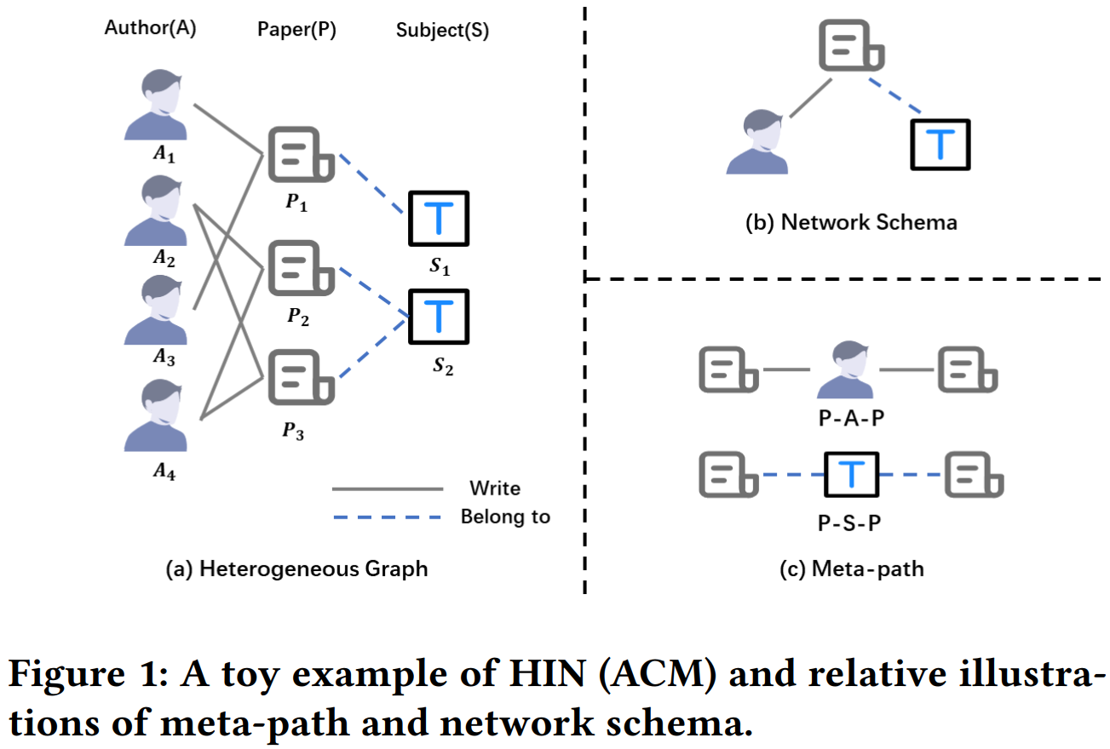
Introduction

Slide 3
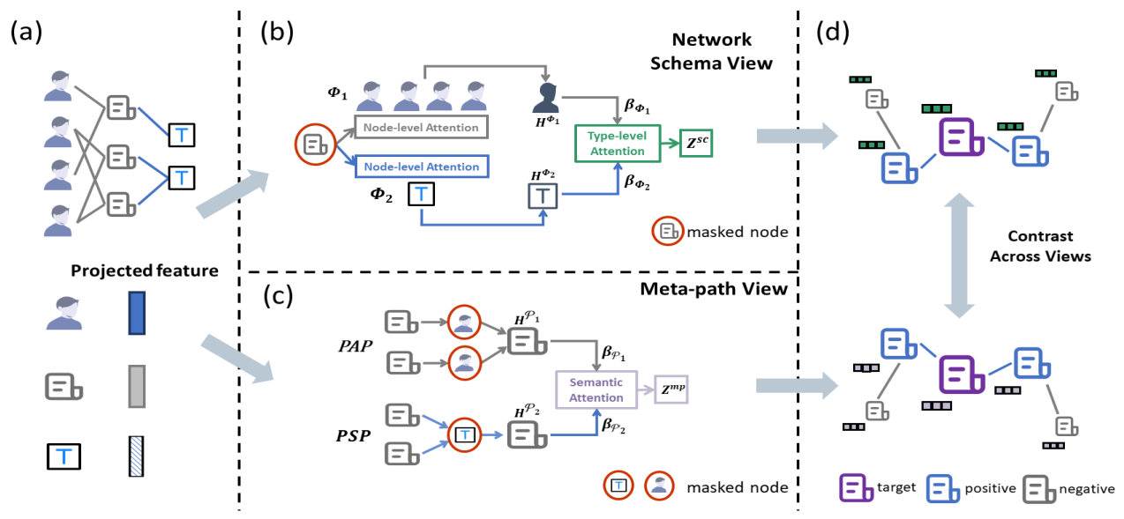
Method
（a）

Slide 4
Method
（b）

Slide 5
Method
（c）

Slide 6
Method
（d）

Slide 7
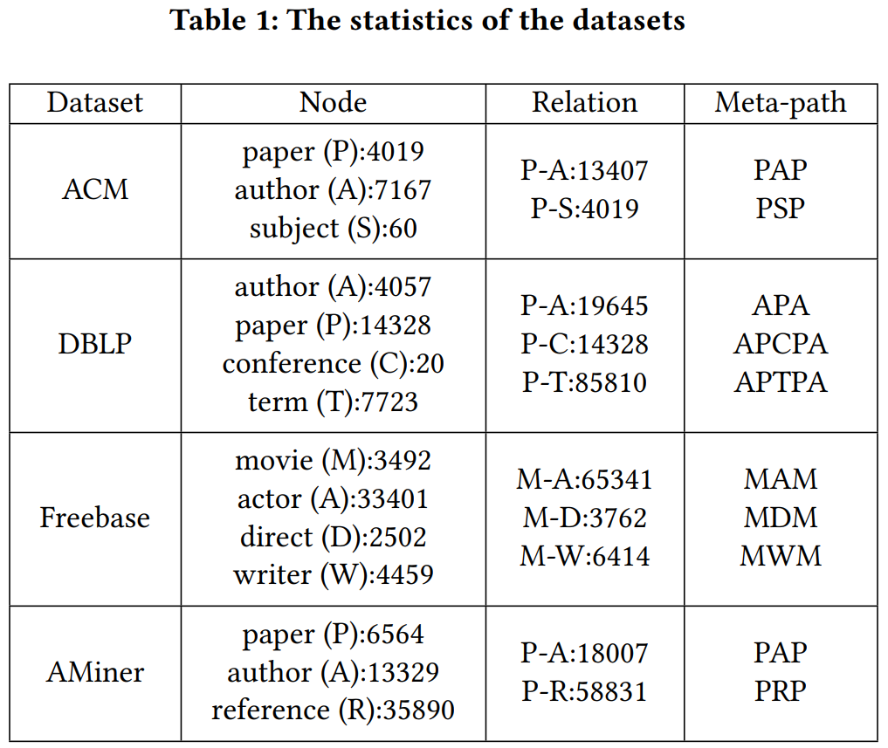
Experiments

Slide 8
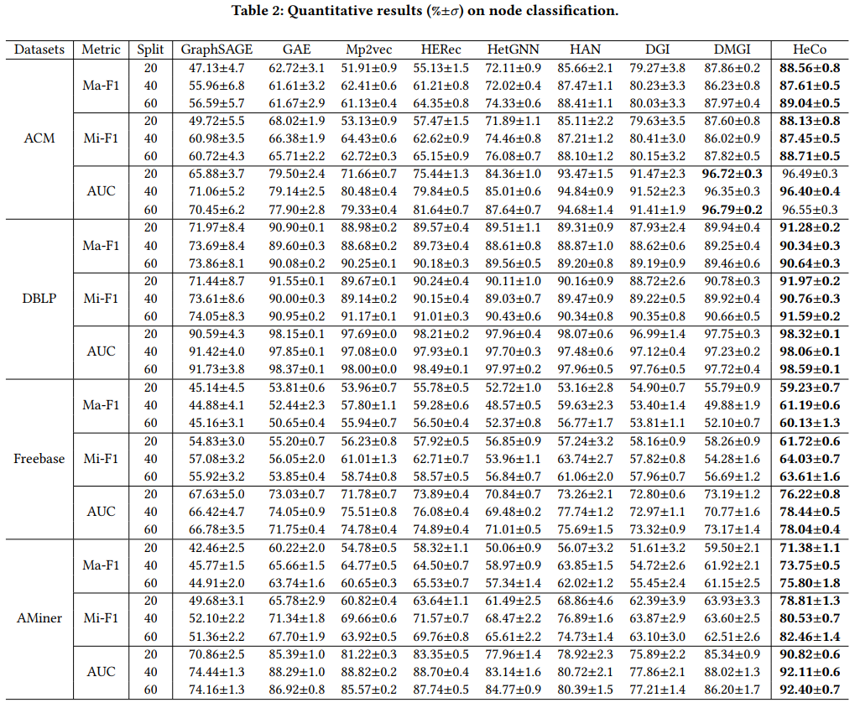
Experiments

Slide 9
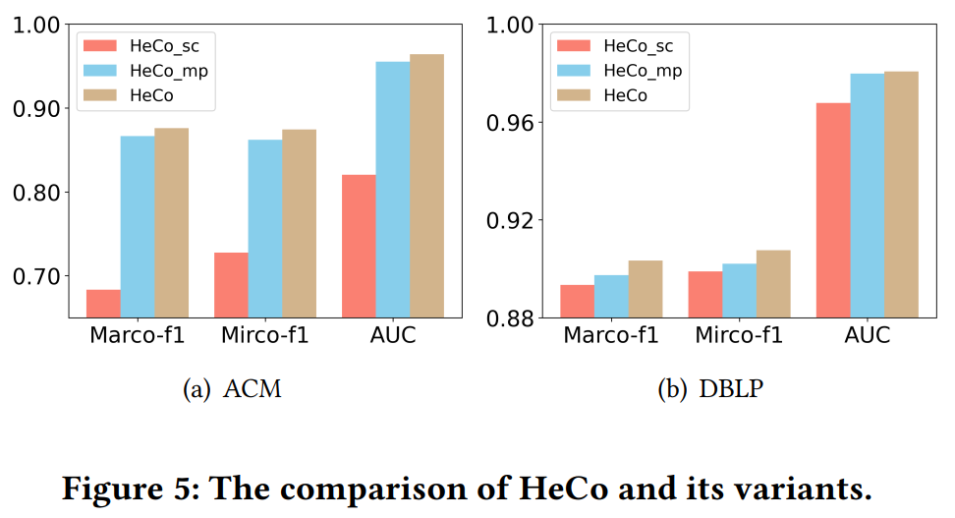
Experiments

Slide 10
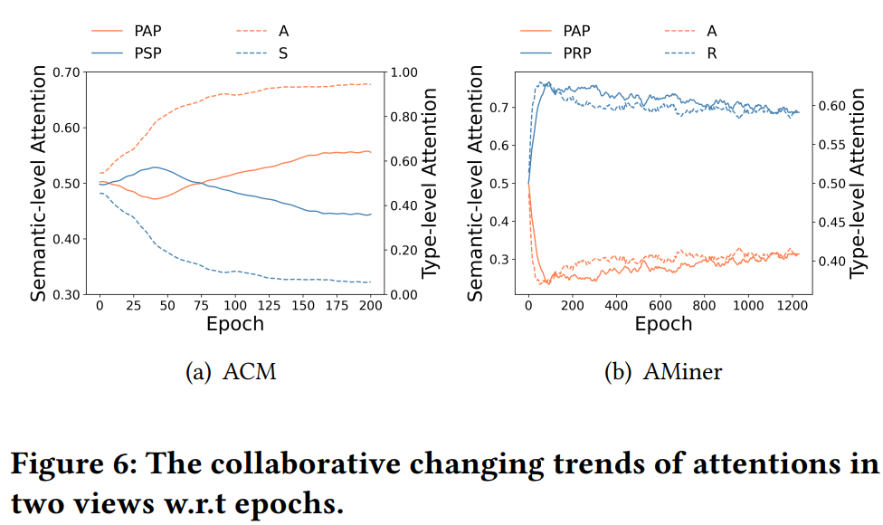
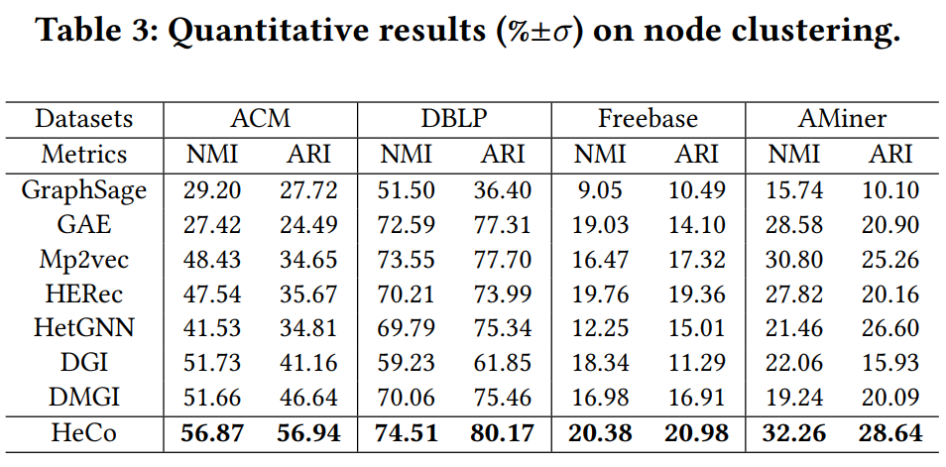
Experiments

Slide 11
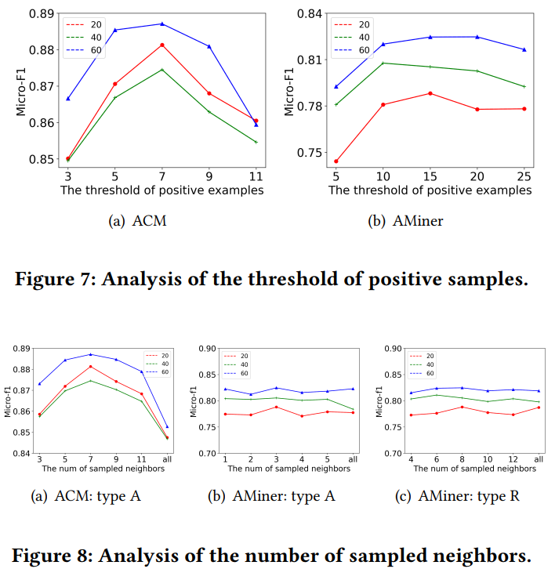
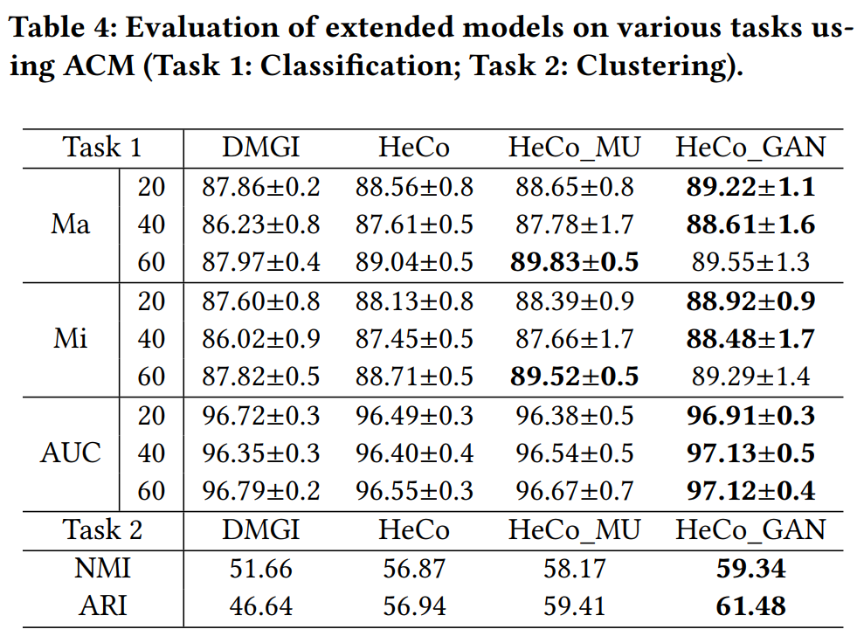
Experiments

